Slide 1
Requirement Engineering in Dev-Ops
Aligning Requirements Management with DevOps Practices

Slide 2
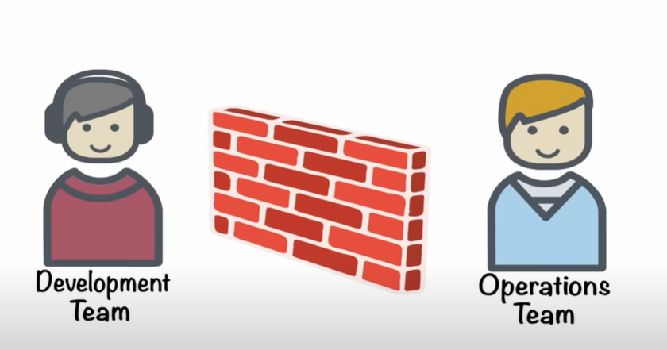
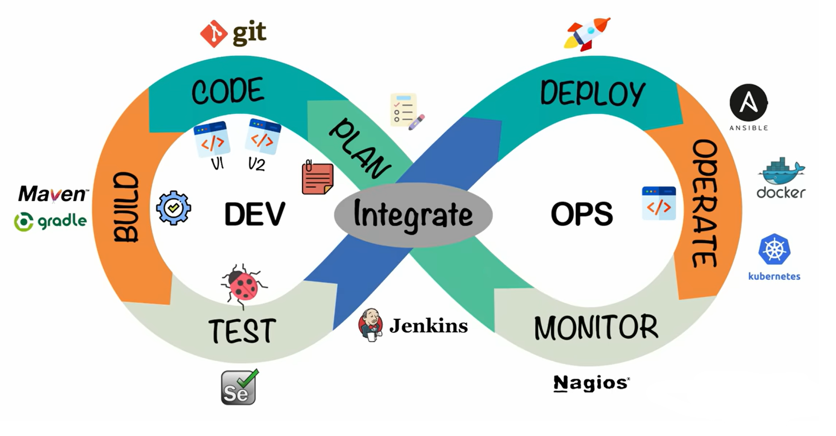
Introduction
What is Dev Ops ?
Requirements Engineering

Slide 3
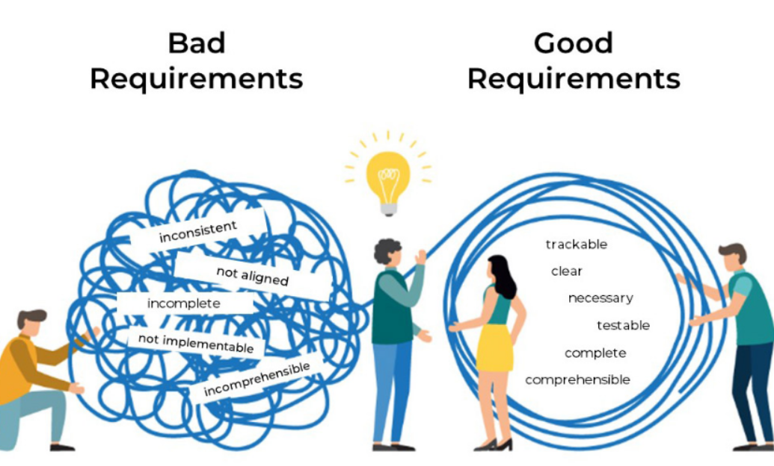
How DevOps Changes Requirements Engineering
CI/CD integration with requirements refinement
Shortened feedback loops
Cross-functional collaboration

Slide 4
Key Challenges
Maintaining Consistent Requirements
Consistent Communication Across Functions Balancing Short-Term and Long-Term Objectives Integration of Automated tools

Slide 5
Best Practices
Tools
Direction
Collaborative tools and automation
Continuous stakeholder engagement
Management
Refinement
Change Management Strategy
Incremental refinement of requirements

Slide 6
Benefits
1
2
3
4
Quick identification of changing requirements
Quality Improvement
Bridging gap between needs and delivered features
Continuous feedback loops

Slide 7
Thanks!
Do you have any questions?

